Slide 1
Predicting Credit Card Approvals
MAHMOUD BAKR
ABD EL RAHMAN SHAHEEN
MAHMOUD NASSER

Slide 2
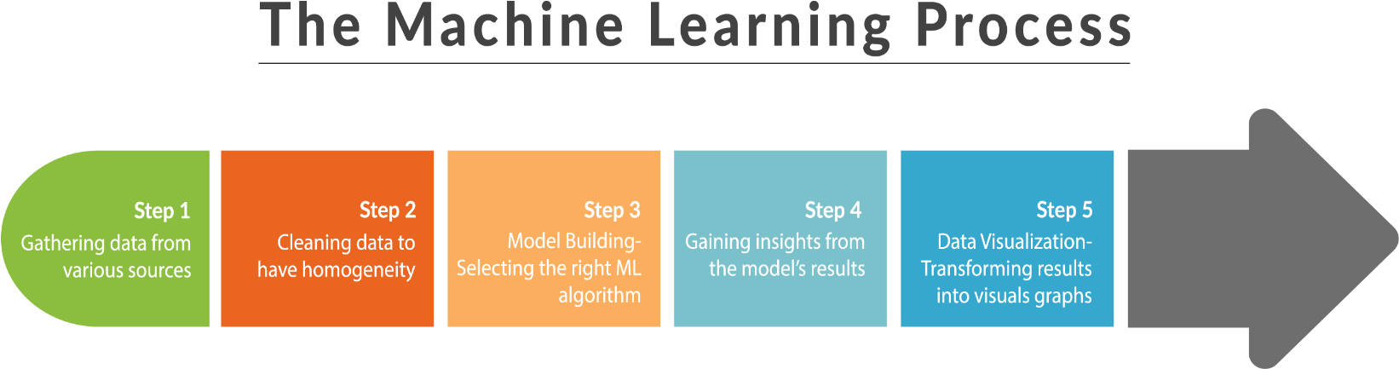
AGENDA
Loading Data
Inspecting Data
Cleaning Data
Preprocessing
Machine learning models
Grid search
Ensemble methods
Data visualization

Slide 3
DATA
COLUMN | Description
A1 | gender
A2 | Age
A3 | Debt
A4 | Married
A5 | Bank Customer
A6 | Education Level
A7 | Ethnicity
A8 | Years Employed
COLUMN | Description
A9 | Prior Default
A10 | Employed
A11 | Credit Score
A12 | Drivers License
A13 | Citizen
A14 | Zip Code
A15 | Income
A16 | Approved
ROWS | COLUMNS
690 | 16

Slide 4

Loading data
Choosing DATA
Using pandas to import data

Slide 5

Inspecting data
Viewing data for verification and debugging purposes

Slide 6

Cleaning Data
Removing nulls
Changing columns types

Slide 7

Preprocessing
Encoding variables
Splitting DATA

Slide 8

Machine learning models
LOGISTIC REGRESSION
DECISION TREE
RANDOM FOREST
K-NEAREST NEIGHBORS

Slide 9
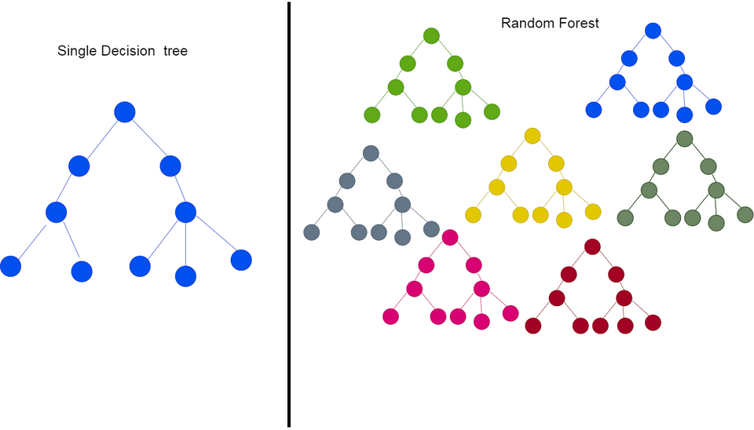

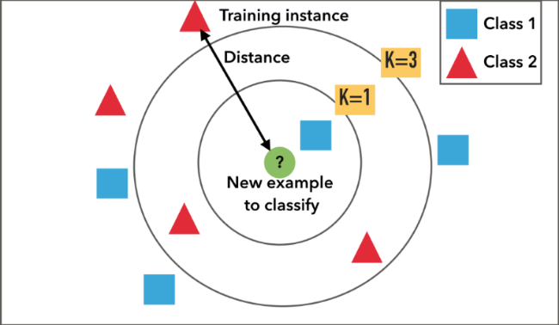
Machine learning models

Slide 10
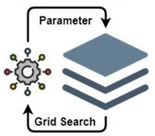
GRID SEARCH
We applied Grid-searching across machine learning models to calculate the best parameters to use

Slide 11
Ensemble methods
Ensemble method
LOGISTIC REGRESSION MODEL
DECISION TREE MODEL
RANDOM FOREST MODEL
K-NEAREST NEIGHBORS MODEL
techniques that create multiple models and then combine them to produce improved results
NEW MODEL

Slide 12
SUMMARY
​ | ACCURACY | GRID SEARCH | Voting Ensemble Model | Averaging Ensemble Model​
LOGISTIC REGRESSION | 82,13 % | 84,54​ % | 85 % | 85.5 %
DECISION TREE | 81,15 % | 84,05​ % | 4.4​ | 3​.0
RANDOM FOREST | 84,06 % | 85,99​ % | 2.5​ | 2.8​
K-NEAREST NEIGHBORS | 82,61​ % | 85,99 %​ | 1.7​ | 7​.0

